Slide 1



01
AP EVENTS
TRENDS ANALYSIS
& SUMMARISATION
Shreya Sharma - 190905131
Internal Guide: Ahamed Shafeeq B M (MAHE, MIT)
External Guide: Winson Fernandes (Juniper Networks)

Slide 2


ABOUT JUNIPER NETWORKS
AND MIST AI
02
Juniper Networks, founded in 1996, is a multinational technology company that provides networking and cybersecurity solutions to businesses and service providers worldwide.
Juniper Networks designs and develops networking equipment, software, and services that enable high- performance, scalable, and secure networks. The company's product portfolio includes routers, switches, security solutions, software-defined networking (SDN) solutions, and cloud services.
Juniper Networks acquired Mist Systems, a pioneer in cloud-managed wireless networks, in 2019. With this, Juniper gained access to Mist's AI-powered platform that helped optimise wireless network performance and improve the overall user experience. This was integrated with Juniper's existing networking solutions, helping Juniper create more comprehensive and intelligent network infrastructure.

Slide 3
03
1
ABSTRACT
5
RESULT ANALYSIS
TABLE OF CONTENTS
2
PROJECT TIMELINE
6
CONCLUSION & FUTURE SCOPE
3
INTRODUCTION
7
REFERENCES
4
METHODOLOGY

Slide 4


ABSTRACT
04
APs are devices that enable wireless connectivity by transmitting and receiving data signals between user devices and a network. In the ever-evolving digital era, maintaining optimal performance and reliability of access points is critical to delivering uninterrupted connectivity and great customer experience.
To fulfil this, this project utilizes exploratory analysis, graphical and textual summarization techniques, anomaly detection and correlation methodologies. By gaining insights into event trends and anomalies, network administrators can make informed decisions, understand causes of and take proactive measures to address potential issues. The correlation analysis is done to further enhance the understanding of the anomalies and the impacted features.
This project identified key organisations, firmware versions, models and other variables that are have strong relation with high issue events. The project contributes to proactive network management, efficient troubleshooting, and improved network performance

Slide 5
PROJECT TIMELINE
05
JAN
FEB
MAR
Understanding existing tools and code
Exploring and reformatting data
Monthly Graphical Reports
Researching Anomaly Detection and Correlation
Adhoc Feature wise Graphical Reports
Exploring textual summaries
APR
MAY
JUN
Monthly Textual Summaries
Feature-wise Textual summaries
Integrating Anomaly Detection Model
Restructuring results to make it more meaningful
Implementing Correlation
Exploring and implementing project on low memory events

Slide 6

06
INTRODUCTION
The project's focus is on trend analysis and summarization of AP events, a topic that is very important in today's networking environment.
With the increasing reliance on access points for uninterrupted connectivity, there is a need to extract valuable insights from the vast amount of event data generated. This project aims to develop effective methodologies that can uncover meaningful patterns, anomalies, and trends in AP events.
The project hopes to improve network management and decision-making procedures in this way. The results of this project will have significant importance, providing network administrators with actionable insights to optimize AP performance, ensure reliable connectivity, and improve overall network efficiency.

Slide 7
GENERAL INTRODUCTION TO TOPIC
07
Wireless Access Points (WAP or APs) are vital networking devices that enable wireless devices to connect to a wired network using WiFi technology. These devices typically come equipped with firmware, a specialised software embedded into the hardware, which controls and manages their functionality and behaviour. Regular monitoring of APs allows organisations to proactively identify and address potential issues, improve customer satisfaction, and maintain a robust and efficient network infrastructure.
Anomaly detection involves identifying deviations or irregularities in access point behaviours that may indicate potential issues or security threats. By detecting anomalies early on, network administrators can take proactive measures to address them, ensuring the smooth operation of the network.
Correlation analysis then aims to identify relationships and dependencies between different variables or features in the access point data. By understanding these correlations, network managers can pinpoint the causes or impacted variables due to the anomaly and make informed decisions to optimize network performance and reliability.
Another critical aspect of analysing AP firmware data is the generation of meaningful and actionable summaries. The use of graphic and textual summarization methods plays a crucial role in presenting complex data clearly and concisely.

Slide 8
OBJECTIVES
MOTIVATION
08
The project focuses on exploratory analysis and summarization of wireless AP events, providing insights into performance patterns and anomalies.
Comprehensive HTML reports are generated, combining textual summaries, graphs, and visualizations for clear interpretation of monthly overviews and specific AP features.
Anomaly detection using LSTM autoencoders helps identify abnormal behavior in AP events, enabling early detection and proactive troubleshooting.
Correlation analysis techniques, including mutual information correlation, uncover relationships between features and pinpoint root causes of anomalies in AP events.
The project's significance lies in its ability to address the pressing need for proactive monitoring and optimization of wireless access points (APs) in today's wireless-dependent world.
Through its innovative approach, combining exploratory analysis, graphical/textual summarization, anomaly detection, and correlation analysis, the project provides valuable insights for network optimization, maintenance, and troubleshooting.
These insights empower network administrators with actionable information to enhance network performance, improve user satisfaction, and minimize downtime.

Slide 9

BACKGROUND THEORY
09
The project focuses on analyzing and summarizing events associated with APs using advanced data analysis techniques. The present literature reveals various research studies on access point optimization, including channel allocation, load balancing, security mechanisms, and more.
Exploratory analysis has gained attention, with advancements in data visualization techniques for effectively exploring patterns, relationships, and trends. Text summarization methods have also seen recent advancements, enabling efficient communication of key insights from complex datasets.
Machine learning algorithms have been extensively applied to detect anomalies across various domains, with a focus on improving accuracy, efficiency, and interpretability. LSTM autoencoders have shown promise in detecting anomalies in sequential data, as they can capture complex temporal relationships and identify deviations from normal behavior.
Mutual information (MI) has been identified as an effective tool for anomaly detection and correlation analysis, thanks to its ability to capture complex relationships and adapt to different data types. Leveraging MI can uncover meaningful associations between features, identify root causes of anomalies, and enhance understanding of data dynamics.

Slide 10

10
METHODOLOGY
The methodology employed in the project involves a systematic approach to extract valuable insights from wireless access point event data. The project utilizes a combination of exploratory analysis, anomaly detection, correlation analysis, and summarization techniques to analyse and summarise trends in the data.
The methodology consists of several steps: data pre-processing, feature extraction, model training, and result visualization.
By applying these techniques, the project aims to provide a comprehensive understanding of AP events, identify anomalies, and correlate them with potential root causes. The methodology ensures a structured and insightful analysis of the data, enabling effective monitoring, troubleshooting, and decision-making in the management of wireless access points.

Slide 11
DATA EXPLORATION AND REPORTS
11
Introduction to the workflow and restructuring data
Understanding the tools and technologies used in the existing workflow
Breaking down the excel reports into multiple csv sheets
Missing values are filled and percentage values are recalculated accordingly
The breakdown was done in multiple levels, as can seen in the following page
Graphical Reports
After restructuring, plotly is used to create visual and interactive plots of the data.
The analysis expands to experimenting to various crossections of data.
A monthly html report was formatted utilising multiple graphs and tables linking to other html pages.
A python code was prepared to generate the report with only input for 'month' and 'year' values
Featurewise reports and code generating that was prepared
Textual Reports
To provide more consice reports on the trends observed, explored textual summaries.
Opted for template based approach that captures key information of the trends and event features.
Code that calls for the data from base sheets stored in cloud and generates an HTML report that provides an overview of each feature, version, and so on, for the month.
By employing this automated template-based approach, we streamlined the process of generating textual summaries and tabular reports, saving time and effort while providing a clear overview of the data.
Simillar templates were used to generate feature wise reports as well.

Slide 12
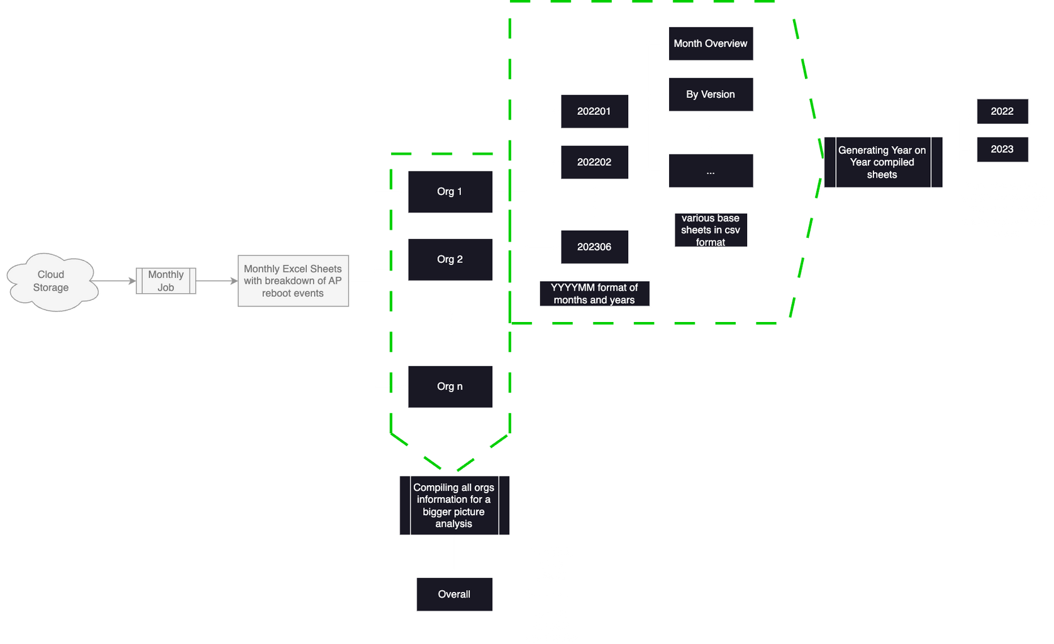
Overview of the restructuring done to analyse AP Reboot Data
12
Example Tables:
YYYYMM | AP Count | Feature 1 | Feature 2
202301 | XYZ | F1 | F2
202302 | XYZ | F1 | F2
YYYYMM | Version | AP Count | Feature 1
202301 | Ver1 | XYZ | F1
202302 | Ver2 | XYZ | F1

Slide 13
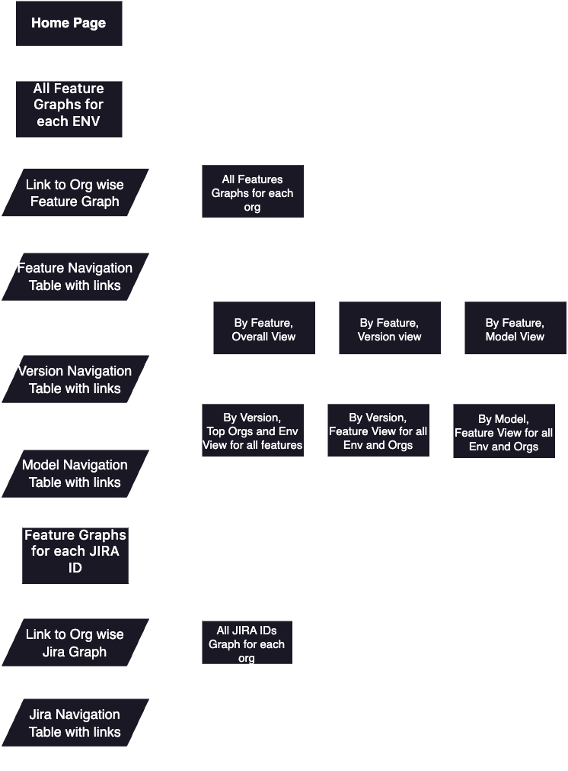
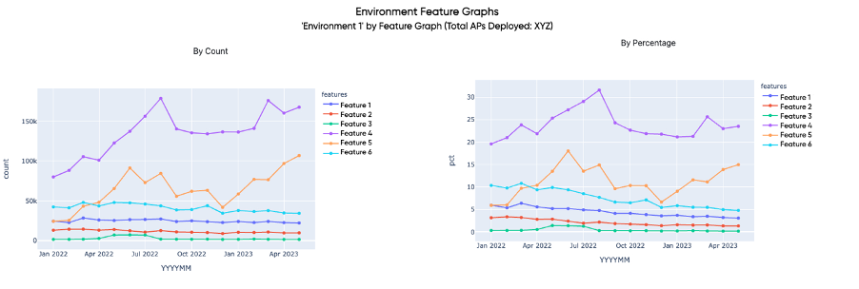
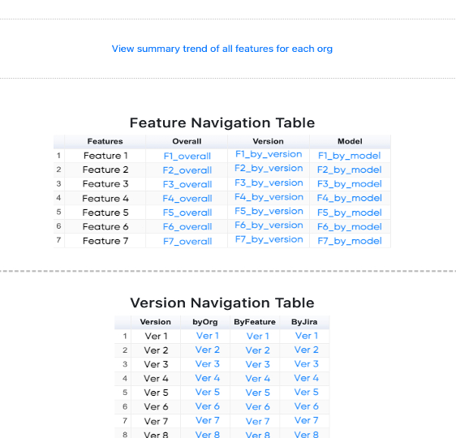
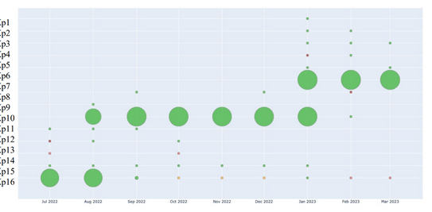
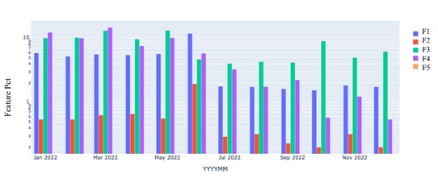
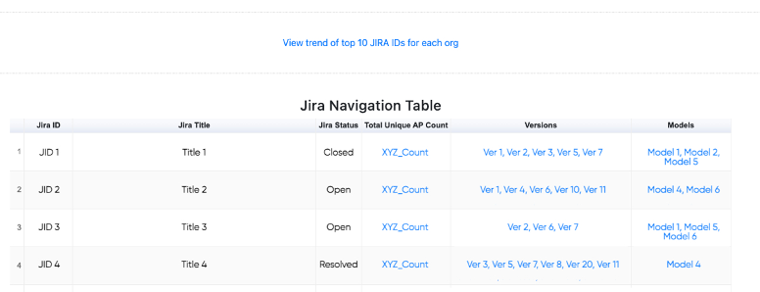
Outline of the flow of monthly report methodology
Example of the outputs and the monthly report generated during graphical analysis
13

Slide 14
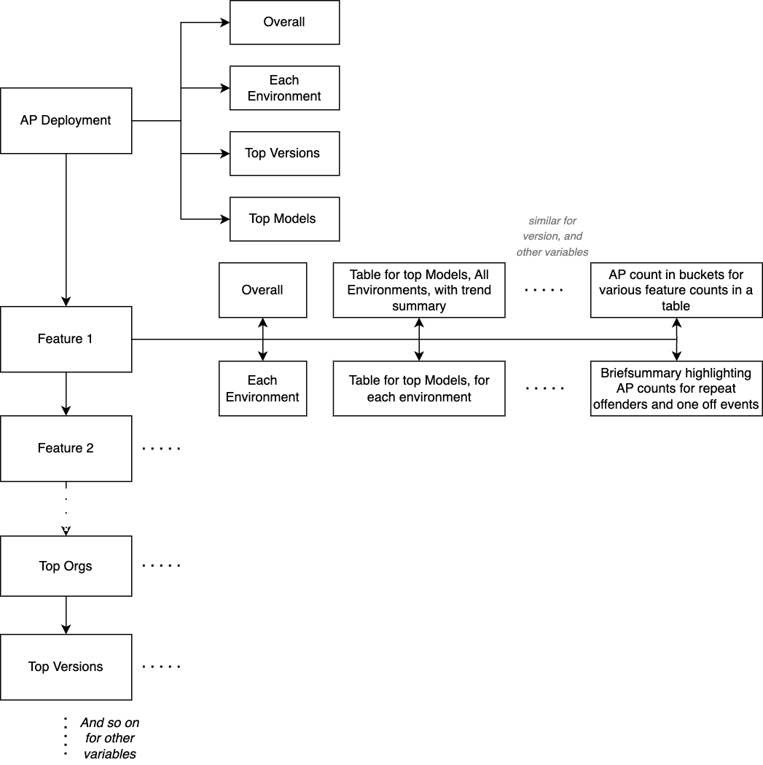
Flow of monthly text report
Examples of the Template and Tables used for reports
Total AP deployment Apr 2023 Summary:
Overall, the Total APs Deployed in Apr 2023 was X_value with 5.4% increase (Y_val AP's) from the Z_value AP's Deployed in Feb 2023.
In ENV1, the Total APs Deployed in Apr 2023 was X1_value with 3.2% increase (Y2_val AP's) from the Z1_value AP's Deployed in Feb 2023.
In ENV2, the Total APs Deployed in Apr 2023 was X2_value with 1.4% increase (Y3_val AP's) from the Z2_value AP's Deployed in Feb 2023.
…
Top Model AP Deployment in Apr 2023
M1 had a Total APs Deployed of X_val in Apr 2023
M2 had a Total APs Deployed of Y_val in Apr 2023
…
Top Version AP Deployment in Apr 2023
V1 had a Total APs Deployed of X_val in Apr 2023
V2 had a Total APs Deployed of Y_val in Apr 2023
…
(And so on for other variables)
Feature Summary for Apr 2023:
In Apr 2023, Feature Pct is 1% where Total AP Deployed was X_count and Unique AP count (UAC) was Y_count. Overall, the Feature Pct has slightly decreased from 2% to 1.62% to 1.38 % (Feb 2023 to Apr 2023) with UAC of Y1_val to Y2_val to Y3_val.
In Env1, the Feature pct is 3.2% where Total AP Deployed was X1_count and Unique AP count (UAC) was Z_count. Overall, the Feature Pct has been relatively stable from 3.4% to 3.5% to 3.4% (Feb 2023 to Apr 2023) with UAC of Z1_val to Z2_val to Z3_val.
14
Buckets | Env 1 | Env 2 | All Env
100+ | 6 | 3 | 9
10 to 100 | 164 | 19 | 183
1 to 10 | 2.3 K | 512 | 2.8 K
Total | 2.4 K | 535 | 2.9 K
Similarly, we approached feature based summaries for each month with similar templates, focusing on the specific type of feature, version, organization, or other specific type of a variable.
Model | Feature Pct | APs Deployed | Unique APs with feature | Trend Summary | Graph
M1 | 1.42 | X | Y | In M1, the Feature Pct is 1.42% where TAD was X and Unique AP count (UAC) was Y. Overall, the feature pct has slightly decreased from 1.6% to 1.64% to 1.42 % (Feb 2023 to Apr 2023) with UAC of Y1 to Y2 to Y3 | LINK
M2 | 3.02 | X | Y | ... | LINK

Slide 15
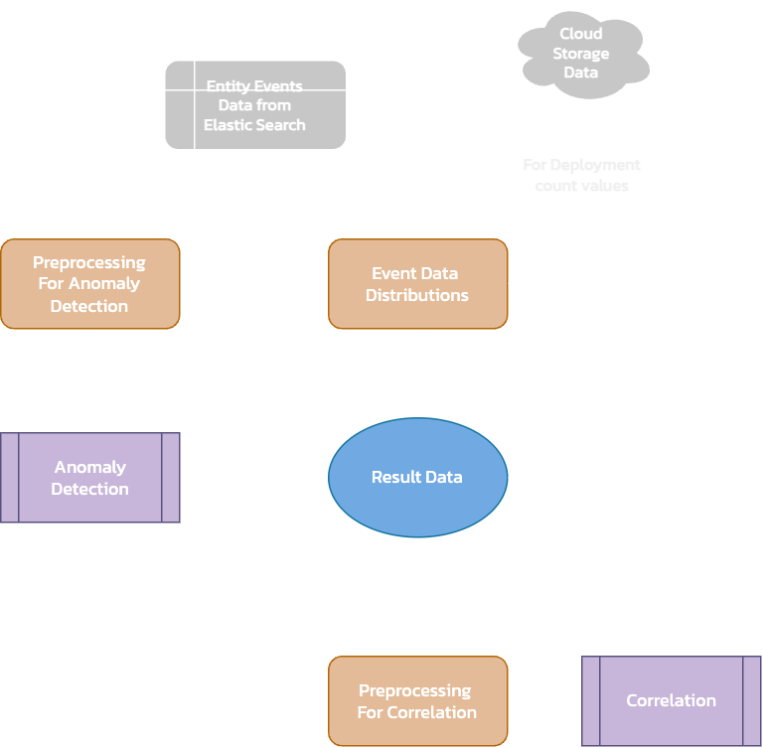
DATA ANALYSIS
15
Data Exploration for all entity event types for event_name low memory, understanding the trends and distributions and identifying key orgs, versions and models affected by low memory events
Anomaly Detection, which is run on the data to identify any event record for a day, org, version and models that is spiked compared to the usual trend of low memory events.
Correlation used to identify relation between low memory events with any org, version, model, and also to relate the anomalous records for a day with specific orgs, sites, versions or models.

Slide 16
16
Occurrence, Duration and Severity Values: Went through the data and noted observations based on the trend of severity, occurrence and duration. Filtered events with severity > 60 as they were noise. Grouped occurrence and duration into buckets to simplify analysis.
Various Distributions Explored: For the excel report with multiple sheets, conducted multiple cross-sections and analysis of data, such as by day, by version, by model , by org, by duration and by occurrence for a more in-depth clear analysis of the event
LOW MEMORY EVENTS: DATA ANALYSIS
Example output of the overview table from the results report:
Event | Unique APs | Pct | Org Count | Version Count | Org: Unique AP | Version : Unique AP | ...
User Low Memory | 456 | 1.60 | 155 | 46 | Org1: 160 Org2: 128 Org3: 103 | Ver1: 306 Ver2: 198 Ver3: 157 | ...
Kernel Low Memory | 123 | 0.24 | 284 | 14 | ... | ... | ...

Slide 17

anomaly detection Model
17
The LSTM autoencoder model used in this project is a neural network architecture that combines the Long Short-Term Memory (LSTM) layers with an autoencoder framework. The purpose of this model is to learn the underlying patterns and representations in the input data by encoding it into a lower-dimensional latent space and then reconstructing the original input from this latent representation.
The Autoencoder takes an input sequence with dimensions, passes it through LSTM layers to encode it into a compressed representation, and then decodes it back to reconstruct the original input sequence.
LSTM autoencoders are effective because they can learn to reconstruct normal patterns in sequential data. During the training phase, the autoencoder learns to reconstruct the input sequence, capturing the temporal dependencies and patterns in the data. However, when presented with anomalous data, which differs significantly from the learned normal patterns, the reconstruction error is typically higher. This difference in reconstruction error can be used to identify anomalies.
We used an unsupervised anomaly detection approach, as it does not require labeled training data, making it more applicable in real-world scenarios where anomalous instances may be scarce or unknown.
Notes:
The LSTM autoencoder model used in this project is a neural network architecture that combines the Long Short-Term Memory (LSTM) layers with an autoencoder framework. The purpose of this model is to learn the underlying patterns and representations in the input data by encoding it into a lower-dimensional latent space and then reconstructing the original input from this latent representation.
AutoEncoder model: Takes an input sequence, passes it through LSTM layers to encode it into a compressed representation, and then decodes it back to reconstruct the original input sequence.
Tested with epoch_range = [50, 100, 150, 200] and corresponding batch_range = [8, 16, 32, 64] for each epoch in epoch_range for general anomaly detection to get these two values

Slide 18

approach for ANOMALY DETECTION
18
MODEL: LSTM Autoencoder Model, Epoch: 50, Batch size: 32,
HOW IT WORKS: The Anomaly detection model currently runs by user input start time, end time, and for event 'low_memory' in a hardcoded list.
ASSUMPTIONS:
•Assuming normal trend of the event remains similar from the previous 15 days
•Assuming lower event count is a positive indicator
DATASET PREPROCESSING:
A filter of severity score > 60 to remove events with low relevance
Using both event_duration and occurrence to calculate a 'score' for the model to be run on
Using duration as a multiplier on occurrence, where the multiplier is 1 if <1 Day, by 1.5 if 1-7 Days and 2 if 7+ Days
MODEL PROCESSING
Inputs: 'datetime' and 'score' (if by distribution, then 'org_id','site_id','model', or 'firmware')
Based on the training, determines 'score' as anomalous or not be calculating Loss_MAE of predicted scores with actual scores, and taking the mean loss_mae as threshold.
If respective loss mae for each record > Threshold, tags that record as Anomaly
Notes:
Tested with epoch_range = [50, 100, 150, 200] and corresponding batch_range = [8, 16, 32, 64] for each epoch in epoch_range for general anomaly detection to get these two values
Explanation of Model Processing:
# Calculating Loss Mean Absolute Error
scores['real_score'] = test['score'].astype(int)
scores['score'] = scores['score'].astype(int)
scores["loss_mae"] = (scores['real_score'] - scores['score']).abs()
# Threshold calculation
loss_mae = scores["loss_mae"].tolist()
train_mae_loss = np.mean((loss_mae))
scores['Threshold'] = np.max(train_mae_loss)
# Checking if score is anomaly or not
scores['Anomaly'] = np.where(scores["loss_mae"] > scores["Threshold"], 1, 0)
scores['Anomaly'] = scores['Anomaly'].astype(int)

Slide 19
ANOMALY DETECTION: REFORMATTED TABLES
19
Org Name | Dates List | Corresponding Anomaly Counts | Low Anomaly Count values count | Medium Anomaly Count values count
Org 1 | ['09-06-2023', '10-06-2023', '11-06-2023', '12-06-2023', '13-06-2023', '14-06-2023', '15-06-2023'] | [1, 3, 2, 15, 5, 3, 3] | 6 | 1
(2)a
Reformatted the output of the anomaly detection into more comprehensible tables for day wise distribution and event wise distribution for the general anomaly detection.
For anomaly detection done by distribution (as in by org, by version and so on), the reformatted tables were also by day distribution for the same and the org (or version, or model and so on) wise distribution of events. This allows us to analyse the anomalous events in various ways
Also added in other indicators to the severity of anomaly, such as derived impact score (calculated using weighted approach giving more weight to anomaly count and less to the max anomaly value), category (high, medium and low), status (such as recent, old, middle and intermittent)
(2)b
Org Name | Total Anomaly Count | Avg. Derived Impact Score | Total Day Count | Status
Org 1 | 32 | 2.56 | 7 | Recent
Example Tables:
(1) Day wise count of anomalies for anomalies
(2) a & b Example of anomalies by distribution results (org-wise) table reformatted to org-wise table
(1)
Datetime | Anomaly Count | Anomaly Value | Occurrence: Anomaly Count Dist | Duration: Anomaly Count Dist | Category | Derived Impact Score | Event
13/06/23 | 8 | 57.4 K | '1000+': 8 | '1-7 Days’: 3 '>7 Days': 5 | low | 10 | Kernel Low Memory
11/06/23 | 17 | 50.2 K | '1000+': 17 | '1-7 Days': 1 '>7 Days': 16 | medium | 9.39 | User Low Memory
... | ... | ... | ... | ... | ... | ... | ...

Slide 20
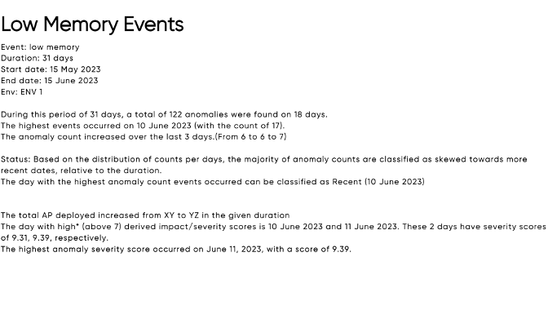
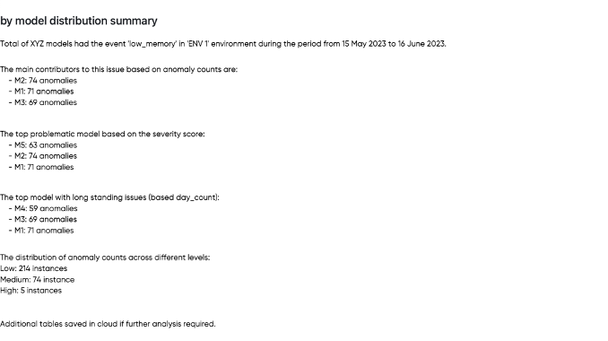
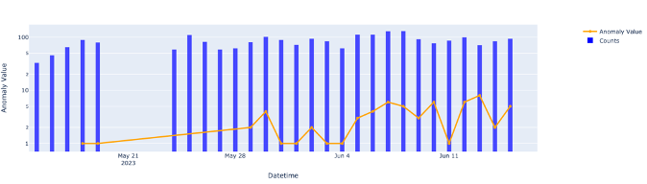
ANOMALY DETECTION HTML REPORT
The reformatted tables are then passed through functions that extract relevant data and add them to templates for textual summaries of results.
This helps provide a concise overview of the anomaly detection output
20

Slide 21
Correlation - MUTUAL INFORMATION
21
Mutual information score measures the statistical dependency between two variables. It quantifies the amount of information that knowing the value of one variable provides about the other variable. In other words, it measures how much information is shared between the variables.
MODEL DETAILS:
Categorical Features: ['datetime', 'model', 'firmware_version', 'org_name', 'dur_bucket', 'occurrence_bucket']
Continuous Feature: ['issue_count']
Target: ['uac']
feature | mi_score | relative mi | Tag
Org | 0.3208 | 1 | Large
Version | 0.1486 | 0.4634 | Medium
Datetime | 0.0848 | 0.2645 | Small
Model | 0.0223 | 0.0685 | Close to 0
... | ... | ... | ...
In our results, we classified MI scores into four categories: large, medium, small and close to 0 to help better understand the scores.
A high mutual information score indicates a strong dependency or relationship between the variables, where knowing the value of one variable can help predict the value of the other variable. On the other hand, a low mutual information score indicates a weak or no dependency between the variables
Following results indicate a high variation in org names with unique ap counts, indicating we can find a major contributor of the event in one of the orgs

Slide 22
CONCLUSION
FUTURE SCOPE
22
Through exploratory analysis, anomaly detection, and the use of mutual information scores, we have gained a comprehensive understanding of AP data trends, identified anomalies, and uncovered important relationships between variables.
The implementation of the LSTM autoencoder model for anomaly detection and correlation using Mutual Information (MI) has proven to be effective in identifying abnormal patterns in AP events data.
The integration of textual summaries, graphical representations, and tabular summaries has enhanced the comprehension and accessibility of the findings, providing the company with concise yet informative insights into the state of the AP system.
One potential area of future scope lies in expanding the anomaly detection capabilities.
The project can incorporate additional types of events
Further work can be done to speed up and refine the anomaly detection algorithm, such as integration of parallelism and dynamically selecting model based on event type analysed
Another way is to integrate real-time capabilities that would allow us to monitor listed events real time and receive reports if any major anomaly has been detected.
Usage of natural language processing models to make the generation of textual summaries more dynamic.

Slide 23
references
23
A Complete Guide to Grouped Bar Charts,” Chartio. https://chartio.com/learn/charts/grouped-bar-chart-completeguide/#:~:text=Visualization%20tools&text=For%20cases%20where%20a%20basic (accessed Apr. 08, 2023).
Plotly, “Plotly Python Graphing Library,” plotly.com. https://plotly.com/python/
“80 types of charts & graphs for data visualisation (with examples),” www.datylon.com. https://www.datylon.com/blog/types-of-charts-graphs-examples-data-visualization
“What is Anomaly Detection? Definition & FAQs,” Avi Networks. https://avinetworks.com/glossary/anomaly-detection/
“Papers with Code - Text Generation,” paperswithcode.com. https://paperswithcode.com/task/text-generation (accessed Apr. 08, 2023).
“Correlation analysis | Analyse correlation between two variables | QuestionPro,” www.questionpro.com. https://www.questionpro.com/features/correlation-analysis.html
Y. A. Rohman, “LSTM auto encoder for anomaly detection,” Kaggle, https://www.kaggle.com/code/yasirabd/lstm-auto-encoder-for-anomaly-detection/notebook (accessed Jul. 6, 2023).
Major Python Libraries used: Tensorflow.Keras for the LSTM model, sklearn.feature_selection for Mutual Information and Plotly for Graphs

Slide 24

THANK
YOU
SHREYA SHARMA
190905131
SEC - D # 16

